Slide 1
Data Migration and Transformation Tool for Amazon RDS Data Warehouses
Name : A.H.RIZHWAN ANSAAR
Batch Code : E11

Slide 2
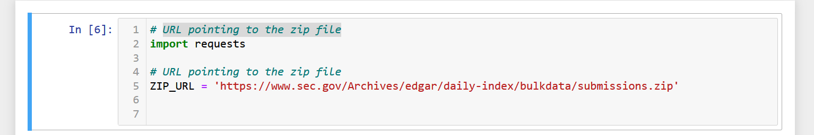
steps to download the zip file from the given URL
Importing the python library request
Paste the URL to download the zip file
URL pointing to the zip file

Slide 3
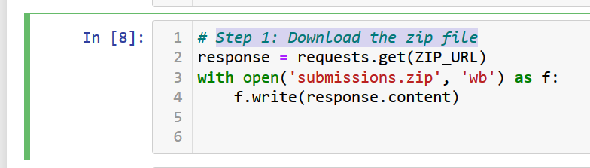
Download the zip file
Downloading the zip file from the given URL
Giving a name to the zip file as submission.zip

Slide 4
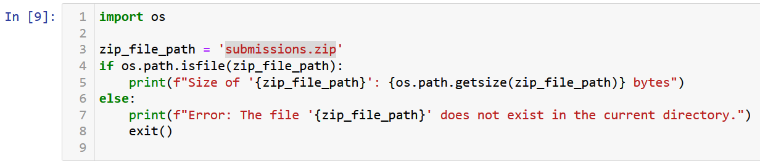
Find the Path were Zipfile is located
To find the path where the zip file is located using python library OS
Also checking the size of the file.

Slide 5
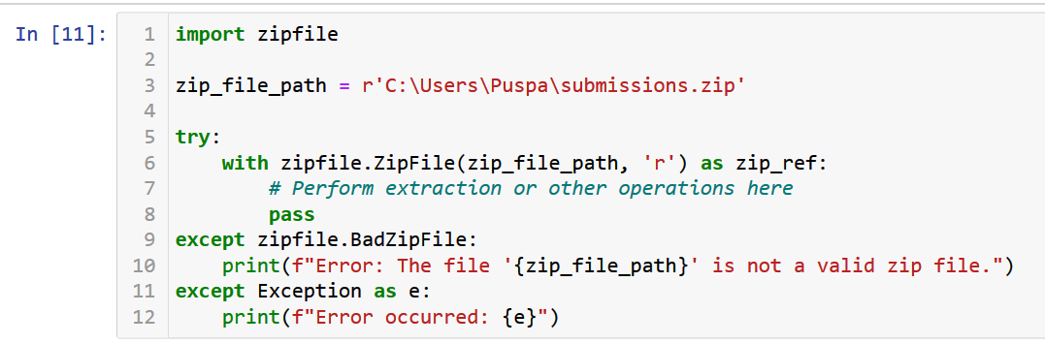
Check whether the Zipfile is opening or not.
To find the path where the zip file is located is valid or not
If path is valid next step is extracting the data

Slide 6
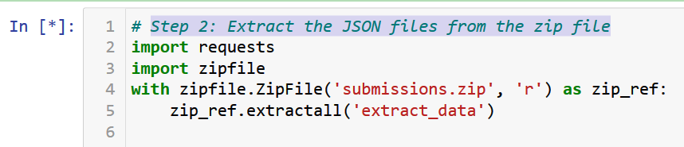
Extract the JSON files from the zip file
Extracting the data from the zip file using python library zip file
Then naming the folder as extract_data

Slide 7
Create RDS Account ,S3 bucket, IAM User in AWS.

Slide 8
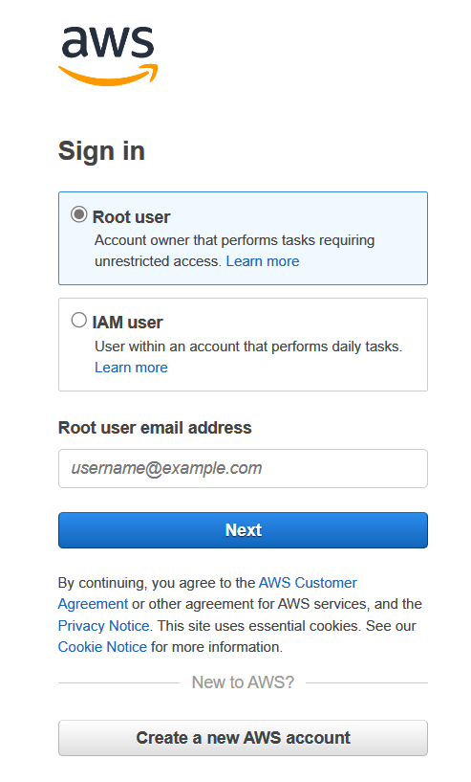
Login AWS Account
https://signin.aws.amazon.com/
Login to AWS Root User using the above link
For study purpose use root user to login
For daily task use IAM user login

Slide 9
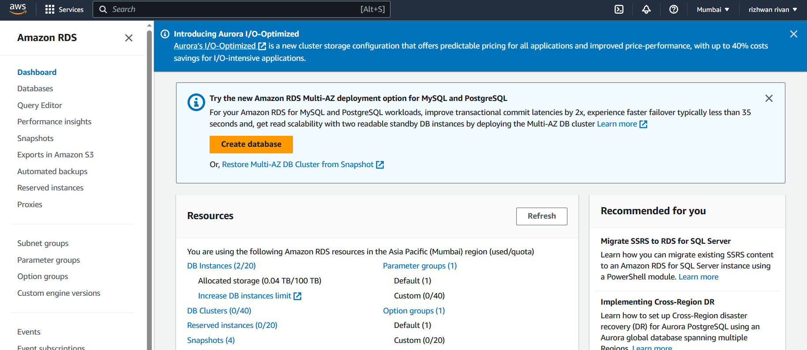
Create RDS Database
First search the RDS after login into AWS account
Then click the create database

Slide 10
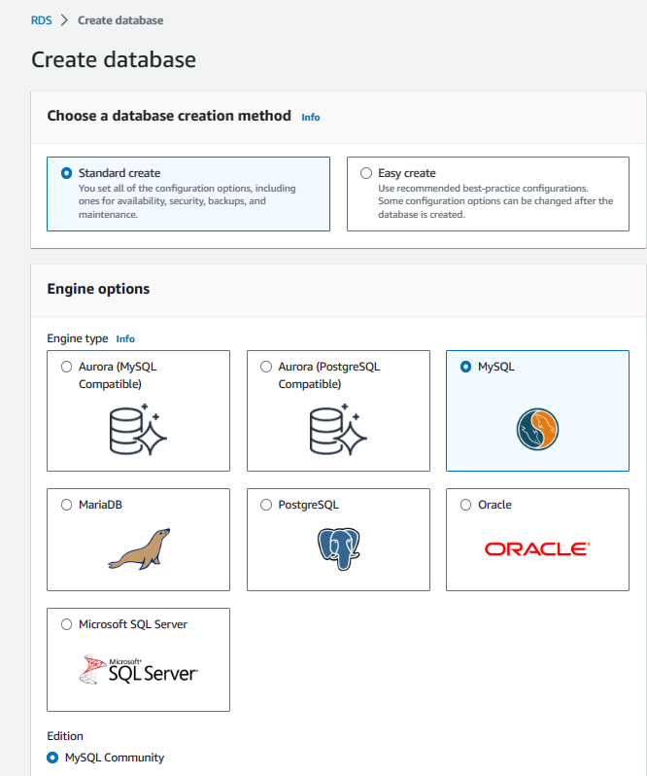
Click Your own Sql Community
Choose the SQL community which is currently working on
I preferred MYSQL community

Slide 11
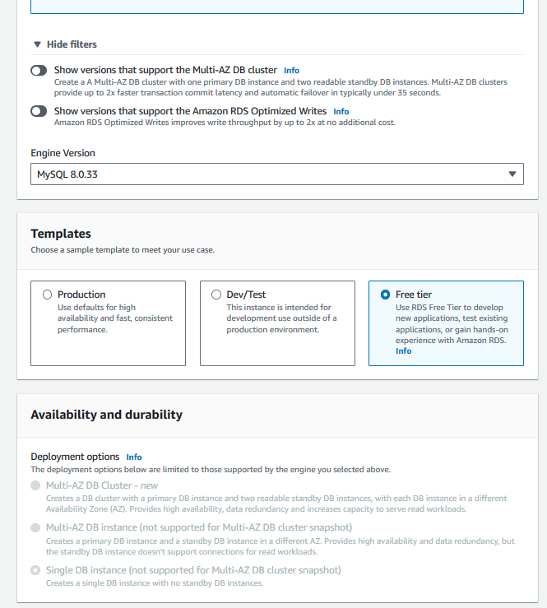
Use Free Tier for Learning Purpose
For study purpose use Free tier
Get some practice using Free tier

Slide 12
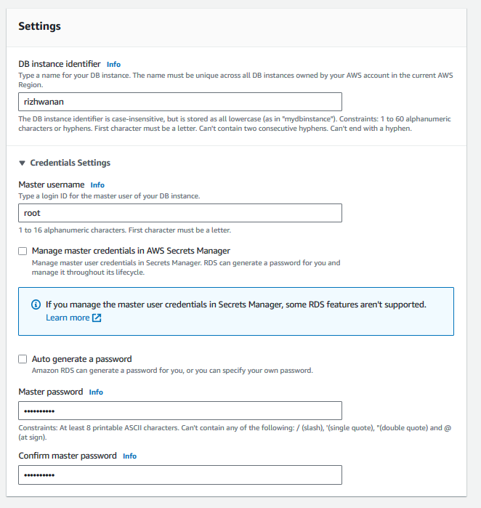
Create DB instance identifier, Master User name & Password.
Create your own username and password to keep the database safe

Slide 13
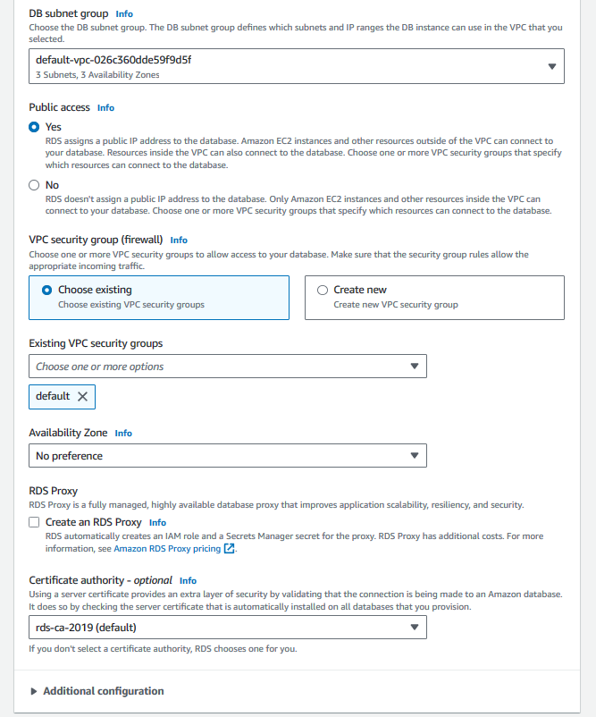
Give Access to Public
While practicing keep using public access
After get into full tech please avoid the public access
Take the final check and then click to create data base

Slide 14
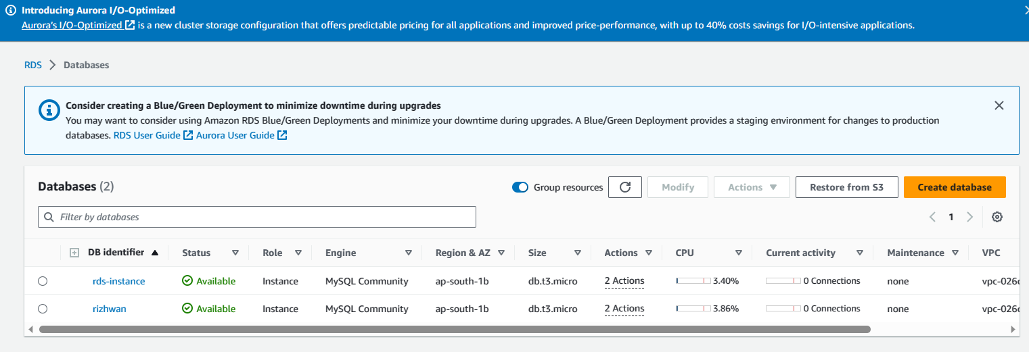
Click the Database you Created
Open the database you created
Check the security link to add the inbound rule

Slide 15
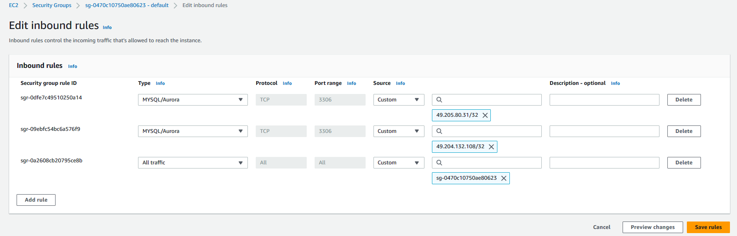
Click the security link to Add Inbound Rule for My Sql Connection
Adding a new inbound rules to avoid error in MY SQL
Add the My Sql connection in inbound rule using source MY IP address.

Slide 16
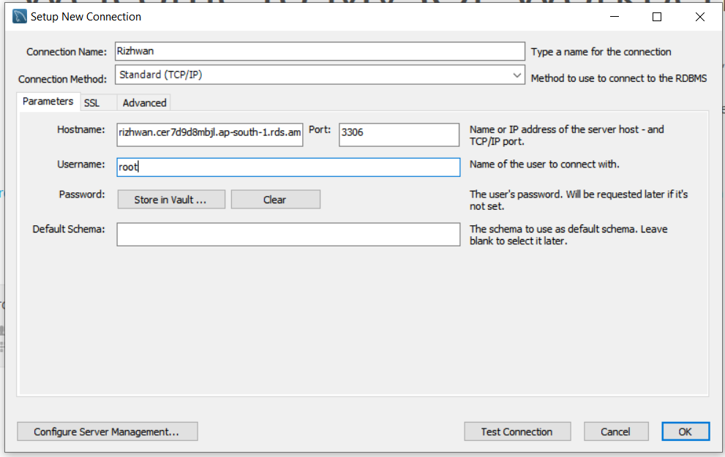
Setup new My Sql connection using RDS Endpoint link & Port
Open the MY SQL Community
Add new Connection with your preferred name
Then copy the End point from RDS
Then paste it in Hostname for Mysql and RDS link
Write the port (3306) and username given in RDS
And password must be stored in vault

Slide 17
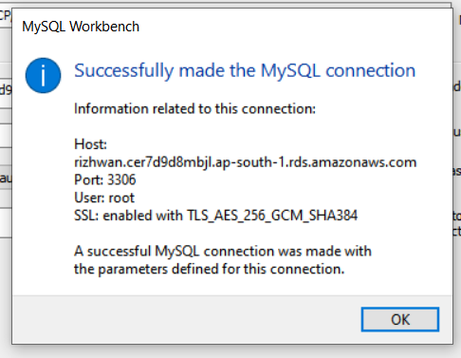
Test the Connection
While finishing all the process after test the connection
If connection is passed the successfully information will get

Slide 18
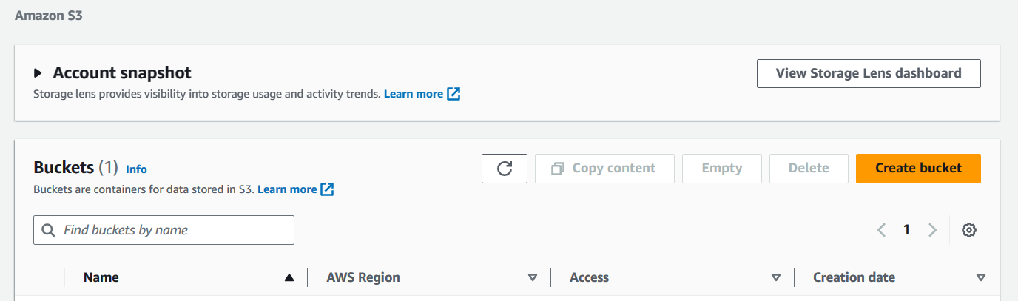
Click to Create S3 Bucket in AWS to store the Extract file
Now open AWS and search S3 bucket to load the extract data
Create the S3 bucket
Give an Bucket name
Click the Block public access to buckets and objects granted through new public bucket or access point policies
Then finally click the create bucket
Then bucket is created

Slide 19
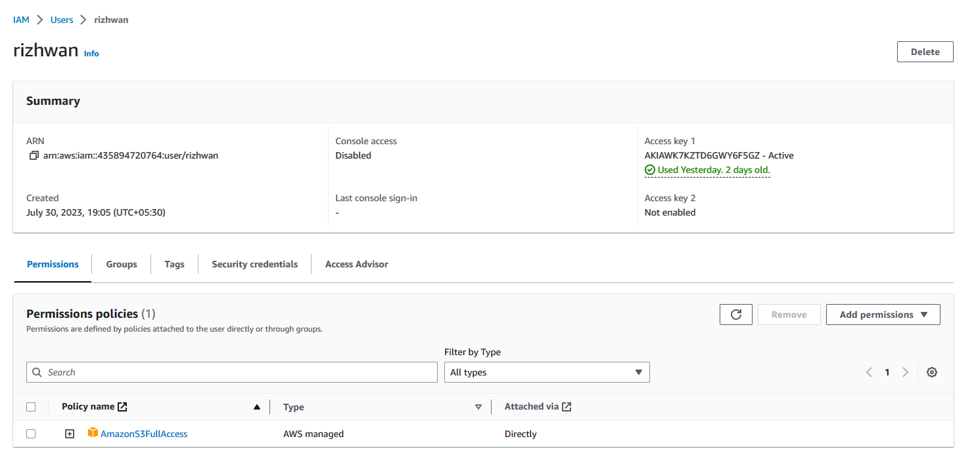
Create IAM User to give full Ascess to load the data in S3 Bucket
Create the IAM User
Give access to the S3 bucket to transform the load from extract file
Copy the Access Key & Password to Notepad.

Slide 20
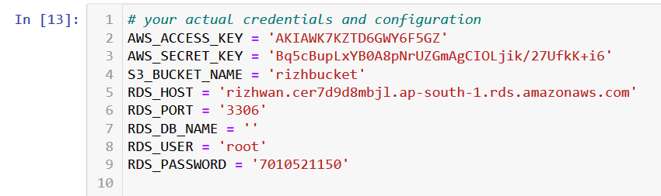
Now create your actual credentials and configuration to Transfrom the data
From the notepad copy and paste the Access key and Secret key
Give you S3 bucket name
Host, Port, DB name, User, Password all these credentials should take from RDS
Give all the above credentials in the given area in jupyter notebook

Slide 21
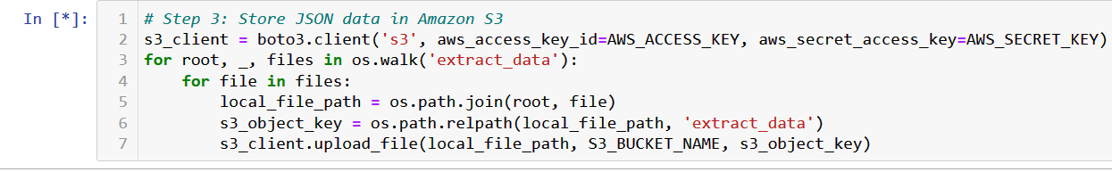
Store JSON data in Amazon S3 Bucket
Write the above command in Jupyter notebook
To transfer the data from local server(Extracted files) to AWS S3 bucket
After code executed check weather the files are transferred in s3 bucket

Slide 22
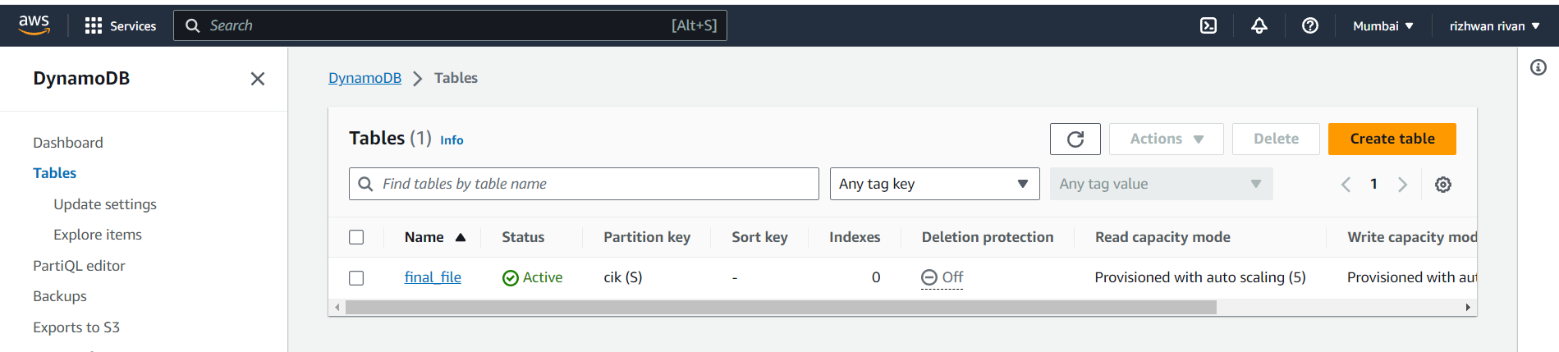
Using DynamoDB transfering the data from S3 bucket to RDS
In AWS Management console search DynamoDB service
Then create the Table for data transfering S3 Bucket to Database

Slide 23
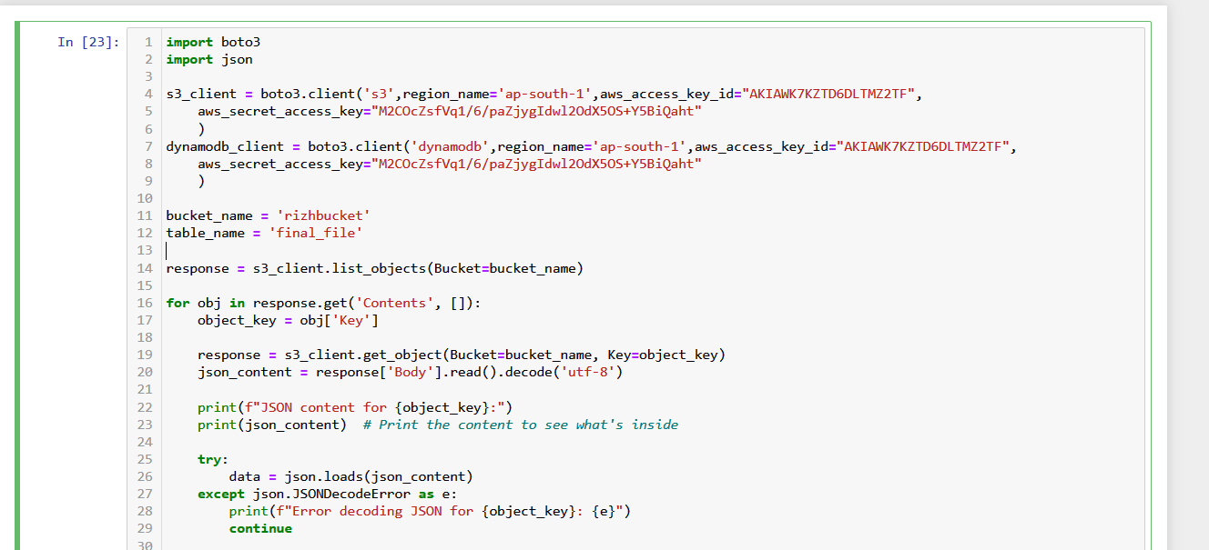
Transform S3 data to Database
To Transfrom the S3 bucket Extract_data to Database use the Above code
Give the correct IAM Access key and Secrect key, Bucket name, DynamoDB Table name
After filling run the code.

Slide 24
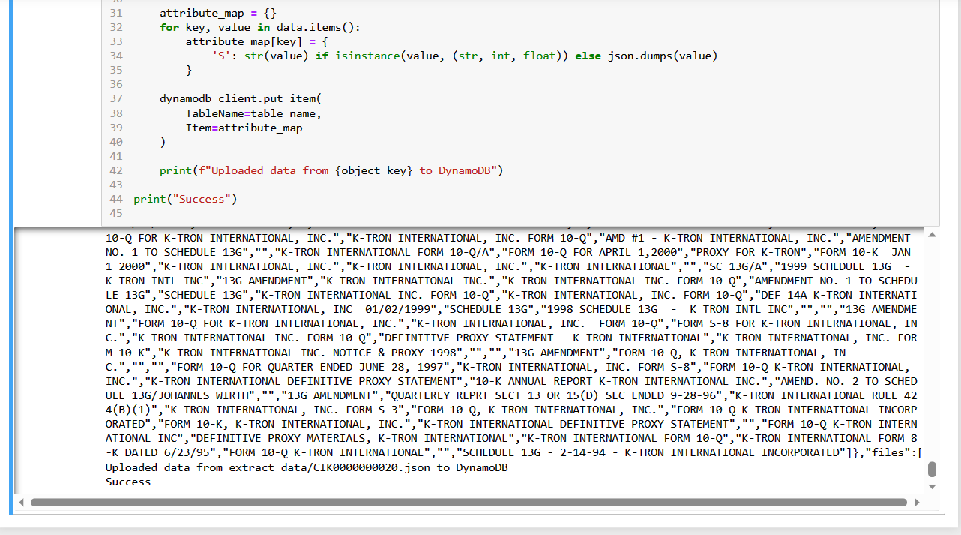
Confrom the Transform S3 data to Database
All the procedures are correct
The result of this will get into Sucess

Slide 25
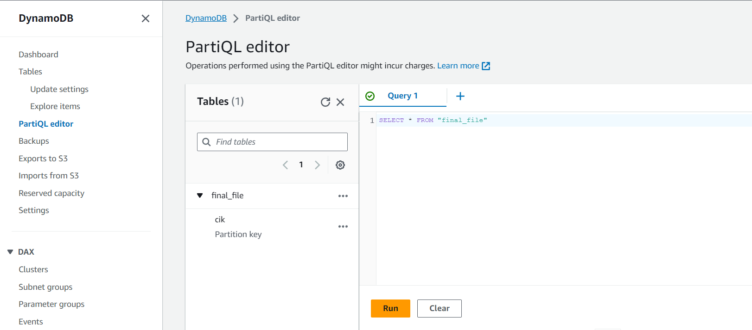
Confrom the S3 Data are Transfered into Database in AWS
In AWS Console open the DynamoDB Service
Then click the PartiQL editor
Then Click the created table
Then Write the Query to find the Data is Transfromed

Slide 26
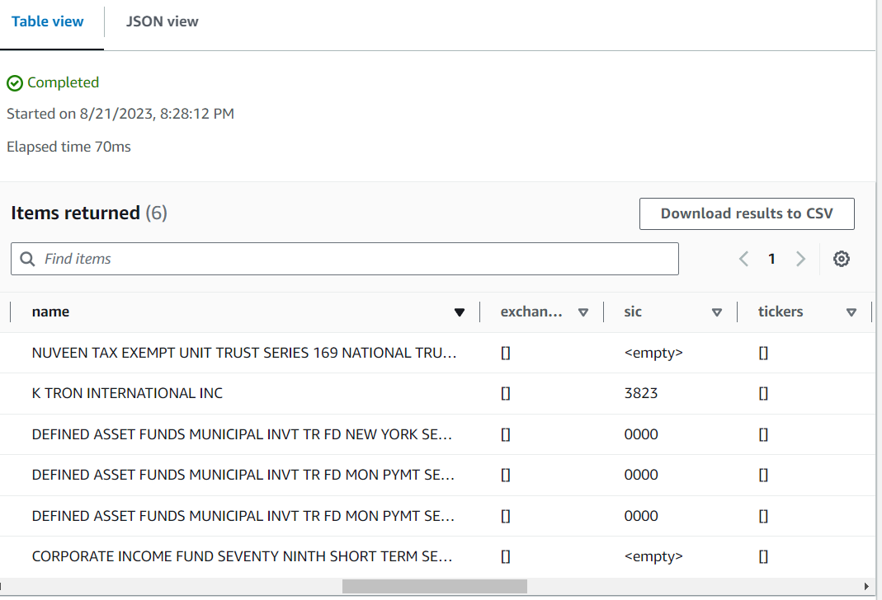
Finally the S3 Data are Transfered into Database in AWS
Finally the Result will show in read format after running the written Query
Then Download the Result

Slide 27
Thank You

